Slide 1





VIRTUAL EVENT PLATFORM
Team Members: Guide:
Rishabh Umredkar Prof. Hrishikesh Mahure
Rajat Wankhede
Ankita Pajai
Disclaimer: The content is curated for educational purposes only.

Slide 2
Virtual Event Platform
OUTLINE
Abstract
Problem Statement
Aims, Objective & Proposed System/Solution
System Design/Architecture
System Development Approach (Technology Used)
Algorithm & Deployment
Conclusion
Future Scope
References
Video of the Project
Notes:
These are the list of chapters that we are going to cover in these foundation codes. Those are chapter one what are AI and ML? chapter 2 applied Python programming in AI, and chapter 3 is exploratory data analysis for ML.

Slide 3
Abstract
Virtual Event Platform
The goal of the Virtual Event Platform project is to simplify event management through the installation of a system with two modules that serve Administrators and Users.
Administrator Module: This module empowers event planners to efficiently input and manage crucial event details, including date, time, ticket costs, seating availability, sponsors, speakers, venue address, and contact information. Administrators can easily update and modify event information as needed, facilitating seamless coordination and communication.
User Module: Designed to offer guests a seamless experience, the User Module allows attendees to log in and browse through the weekly events curated by administrators. Users can effortlessly select events based on dates, explore event details, and purchase tickets with ease, enhancing accessibility and convenience.

Slide 4
Problem Statement
Virtual Event Platform
"Virtual event platforms offer exciting opportunities for global connectivity, but they also come with their challenges. here the problem statement of Virtual Event Platform are….
Administrative inefficiencies :- Manual event management procedures take a lot of time, are prone to mistakes, and cannot be scaled.
Limited Audience Reach :- Participation in traditional in-person events is limited by venue capacity and geographic restrictions.
User Experience Barriers.

Slide 5
Aim and Objective
Virtual Event Platform
The aim and objective of virtual event platforms is to facilitate online events as well as Venue event by providing tools and features for hosting engaging events.
Enhance accessibility: Virtual event platforms make it easier for people from different locations to attend events without the need for physical travel.
Provide flexibility: Virtual event platforms allow organizers to customize event schedules, content, and formats to suit their specific needs and preferences.
Foster networking opportunities: Through virtual event platforms, attendees can connect with each other, exchange contact information, and build professional relationships, fostering networking opportunities.

Slide 6
Proposed Solution
Virtual Event Platform
To address the challenges of event management and enhance user experience, the Virtual Event Platform project proposes the development of a comprehensive system comprising two modules: the Administrator Module and the User Module.
Administrator Module: Enables event planners to efficiently manage event details such as date, time, tickets, seating, sponsors, speakers, venue, and contact info.
User Module: Designed for attendees to log in and browse weekly events curated by administrators, providing a seamless experience.

Slide 7
System Architecture
Virtual Event Platform
MODELS
Our project (Virtual Event Platform) is for Event management system with their respective needs, a short modulation of our project is-
Virtual Event Platform
User
Online Event
Venue Event
Administrator
Add Event/
View Event

Slide 8
System Deployment Approach
Virtual Event Platform
Technologies Used:
Front-End Technologies:
Back-End Technologies:
Html
Css
JavaScript
Bootstrap
Servlet (JSP)
Java
MYSQL
IDE : | Eclipse IDE
Services : API : | Apache Tomcat Server JDBC

Slide 9

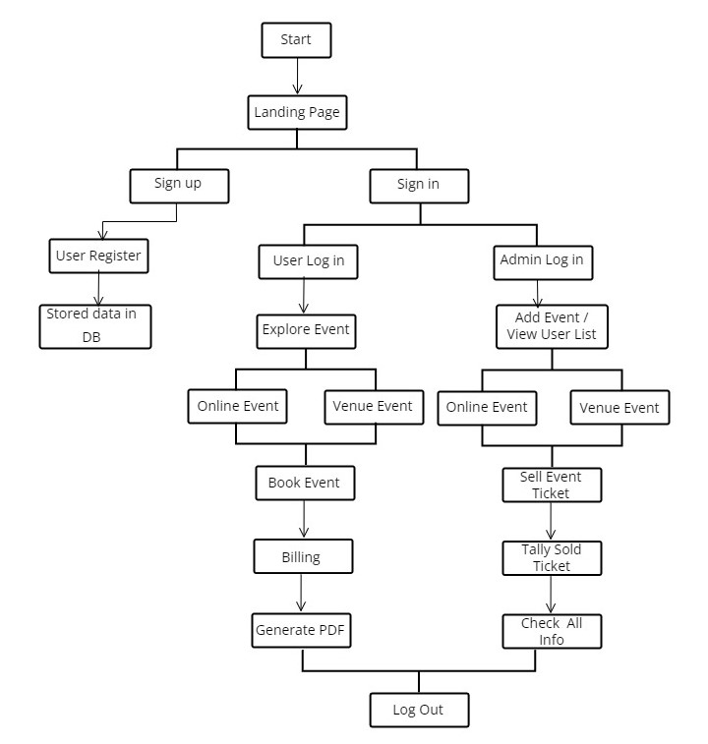
Algorithm & Deployment
Virtual Event Platform

Slide 10
Conclusion
Virtual Event Platform
In conclusion, the proposed Virtual Event Platform presents a solution to the challenges faced in event management by offering a comprehensive system comprising the Administrator and User Modules. Through the Administrator Module, event planners gain the ability to efficiently input and manage event details, ensuring accuracy and coherence. Meanwhile, the User Module provides attendees with a seamless experience, allowing easy event browsing, ticket purchasing, and secure transactions.

Slide 11
Future Scope
Virtual Event Platform
The future scope of the Virtual Event Platform involves continual enhancements and expansions to further streamline event management and enhance user experience.
Better Understanding of Users: Adding tools to understand how users behave, which events are popular, and trends in ticket sales. This helps organizers make smarter decisions using data.
Improved Communication: Adding more ways for attendees and organizers to talk, like chat or forums. This makes it easier for people to interact and feel like they're part of a community.

Slide 12
Virtual Event Platform
Reference
http://www.oreilly.com/data/free/the-new-artificial-intelligence-market.csp
"Secure and Efficient Ticketing Systems for Virtual Events" by M. A. Khan et al. (2021).
"Building Effective Virtual Event Platforms: A Comparative Analysis of Features and Functionality" (2022) by A. Brown, N. Garcia, and C. Miller.
"A Framework for Managing and Analyzing Sponsorships in Virtual Events" (2021) by Markus Böhm, Daniel Beimborn, Alexander Mädge.
"Designing and Evaluating User Interfaces for Virtual Event Platforms" (2023) by Anna Ilieva, Daniel Smirz, Martin Schreiner, Daniel Weiskopf.
5. Doe, J., & Smith, A. (2021). "Enhancing Virtual Event Platforms: A User-Centric Approach." Journal of Interactive Technology, 14(2), 123-145.
Notes:
Reference
These are the references for this session.
12

Slide 13
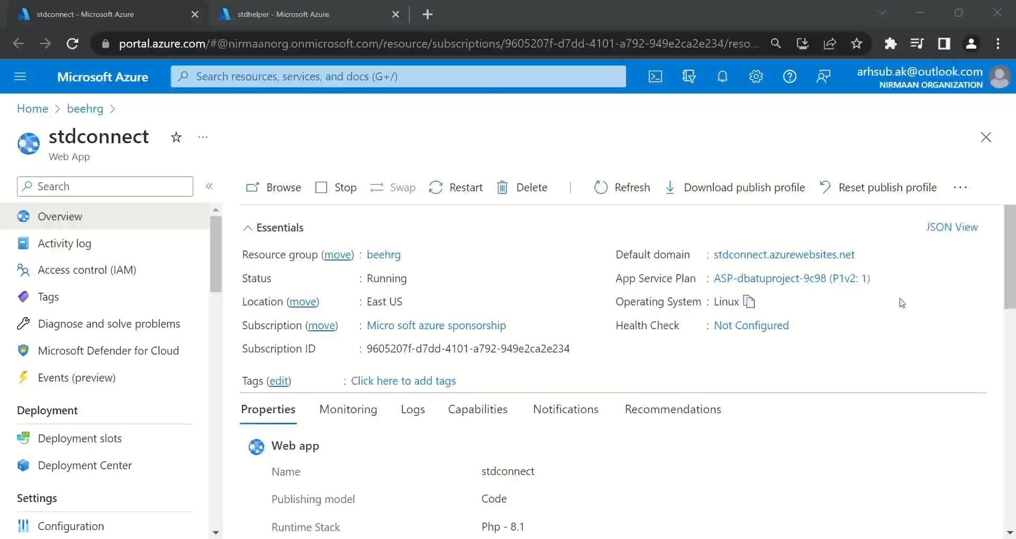
Virtual Event Platform

Slide 14
Virtual Event Platform
Thank you!
Notes:
thank you very much for joining this PPT, keep learning.
14

